Slide 1
Clear Trip (AirLine Ticket Booking)
By
Sandhiya J

Slide 2
Requirements:
Navigate to url
Select the round trip
Select from New Delhi to Mumbai
Select depart on 1st July and return on 8th July
Click more options on url
Select business class
Take the screenshot of results pages
Select only non stop flights
Take screenshot of non stop flights
Capture total price of the ticket
Click on book
Verify the price is same as in step 10
Click on continue
Verify the same price is still in continue page

Slide 3
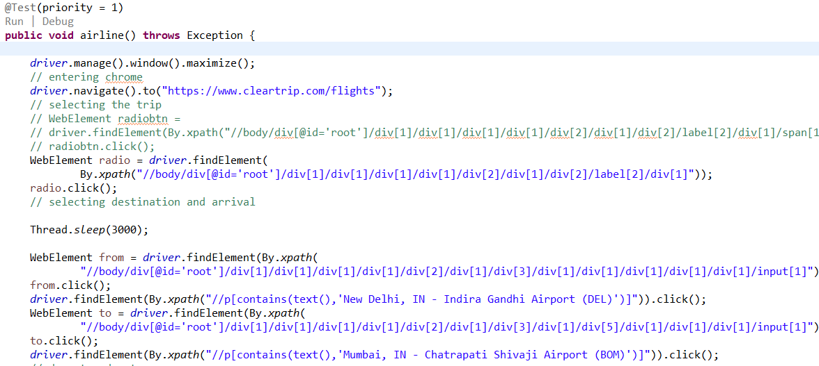
Step1: Navigate to url Step2: Select roun trip Step3: Select From: New Delhi To: Mumbai

Slide 4
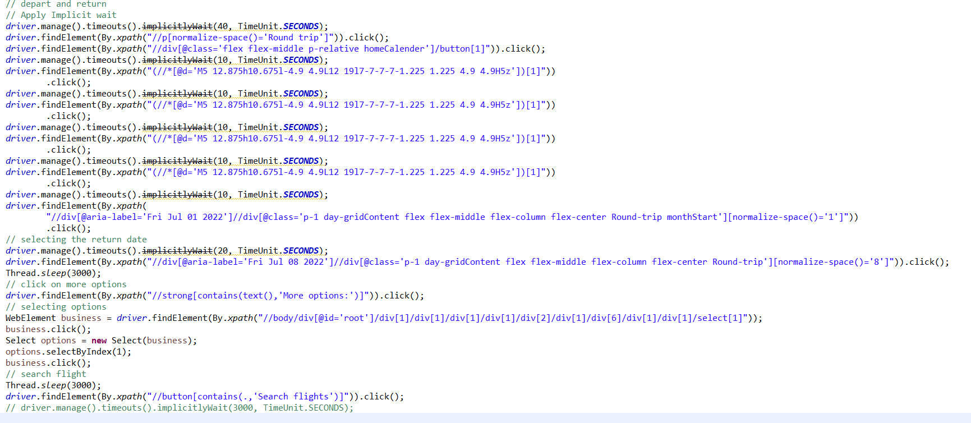
Step4: Select Depart on 1st July and Return on 8th July Step5: Click on the More options URL Step6: Select Class of Travel as “Business” Step7: Click on Search Flights

Slide 5
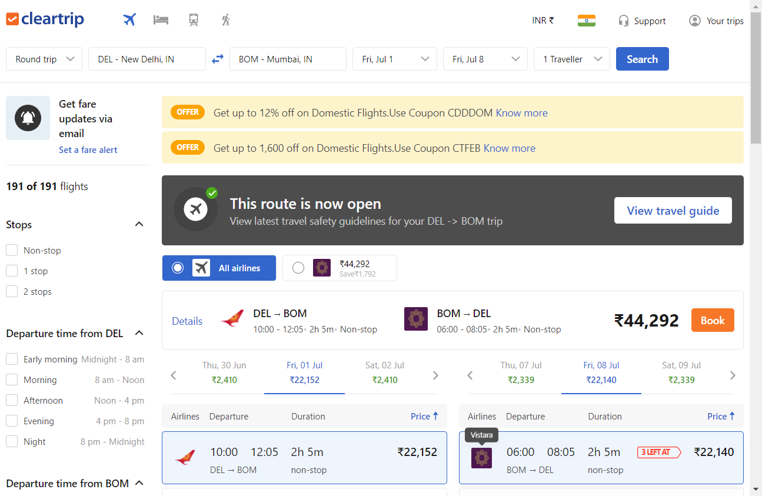
Step8:take screenshot of the results page

Slide 6
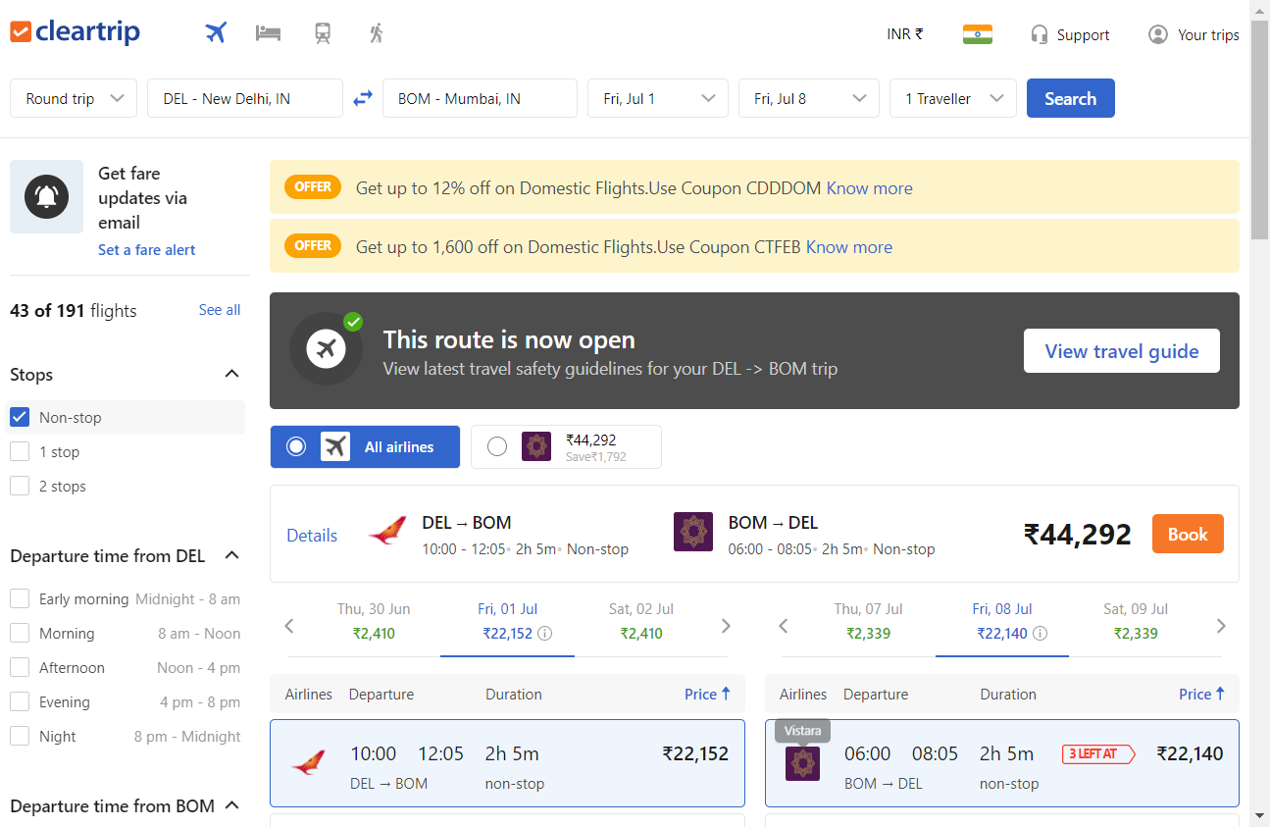
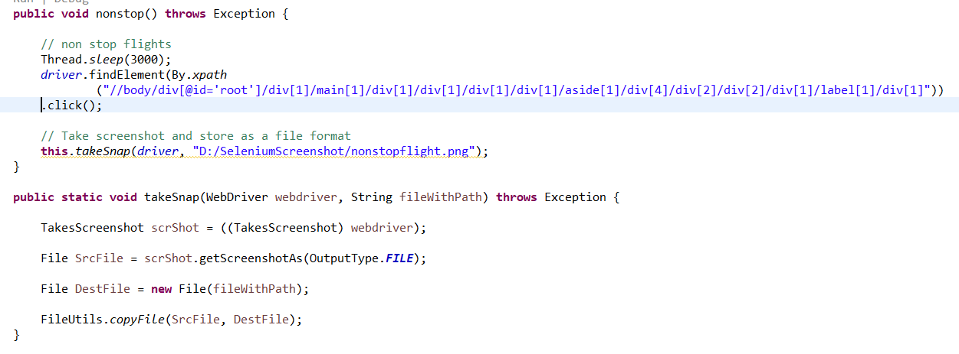
Step9: show only non stop flights Step10: Take screenshot of this page with only non stop flights

Slide 7
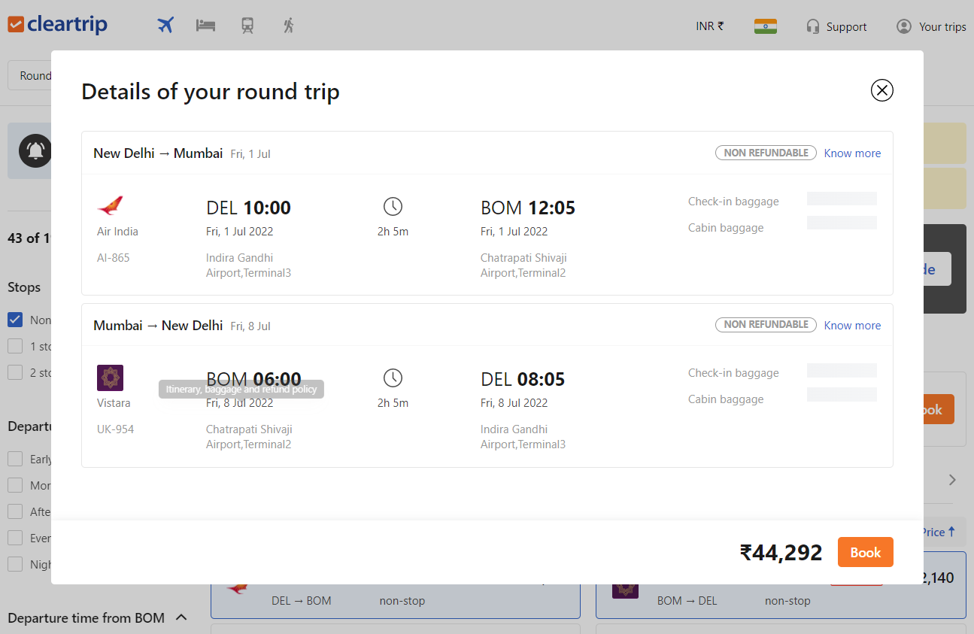
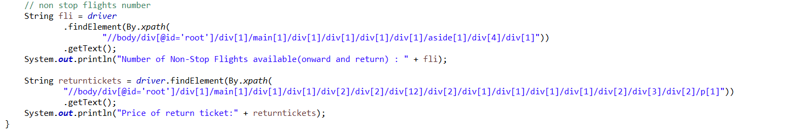
Step11:Find the number of flights each available in each leg(onward and return) Step12:Capture the total price of the ticket

Slide 8
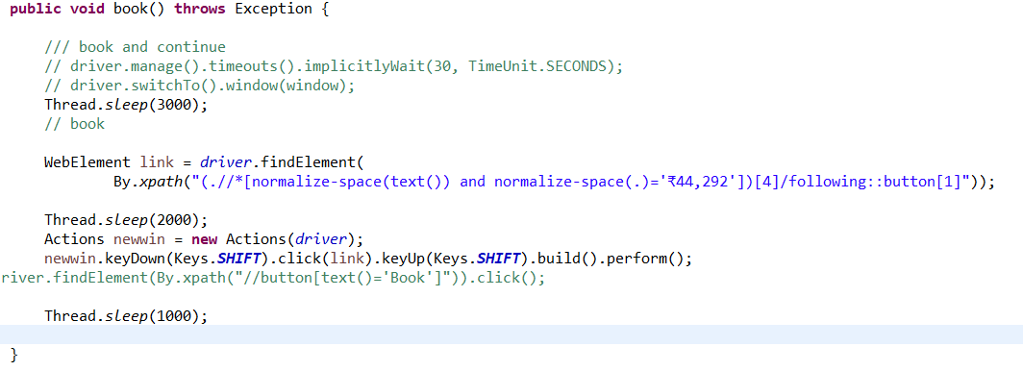
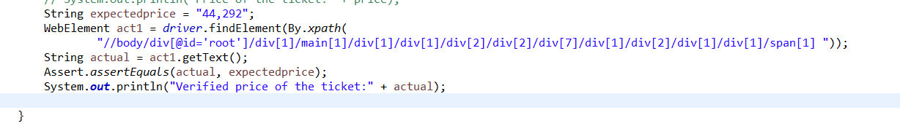
Step13:click on book Step 14: Verify the price is same as in before

Slide 9
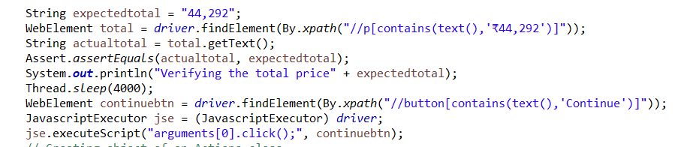
Step15: Click on continue Step16:Verify the Price is still same as in before

Slide 10
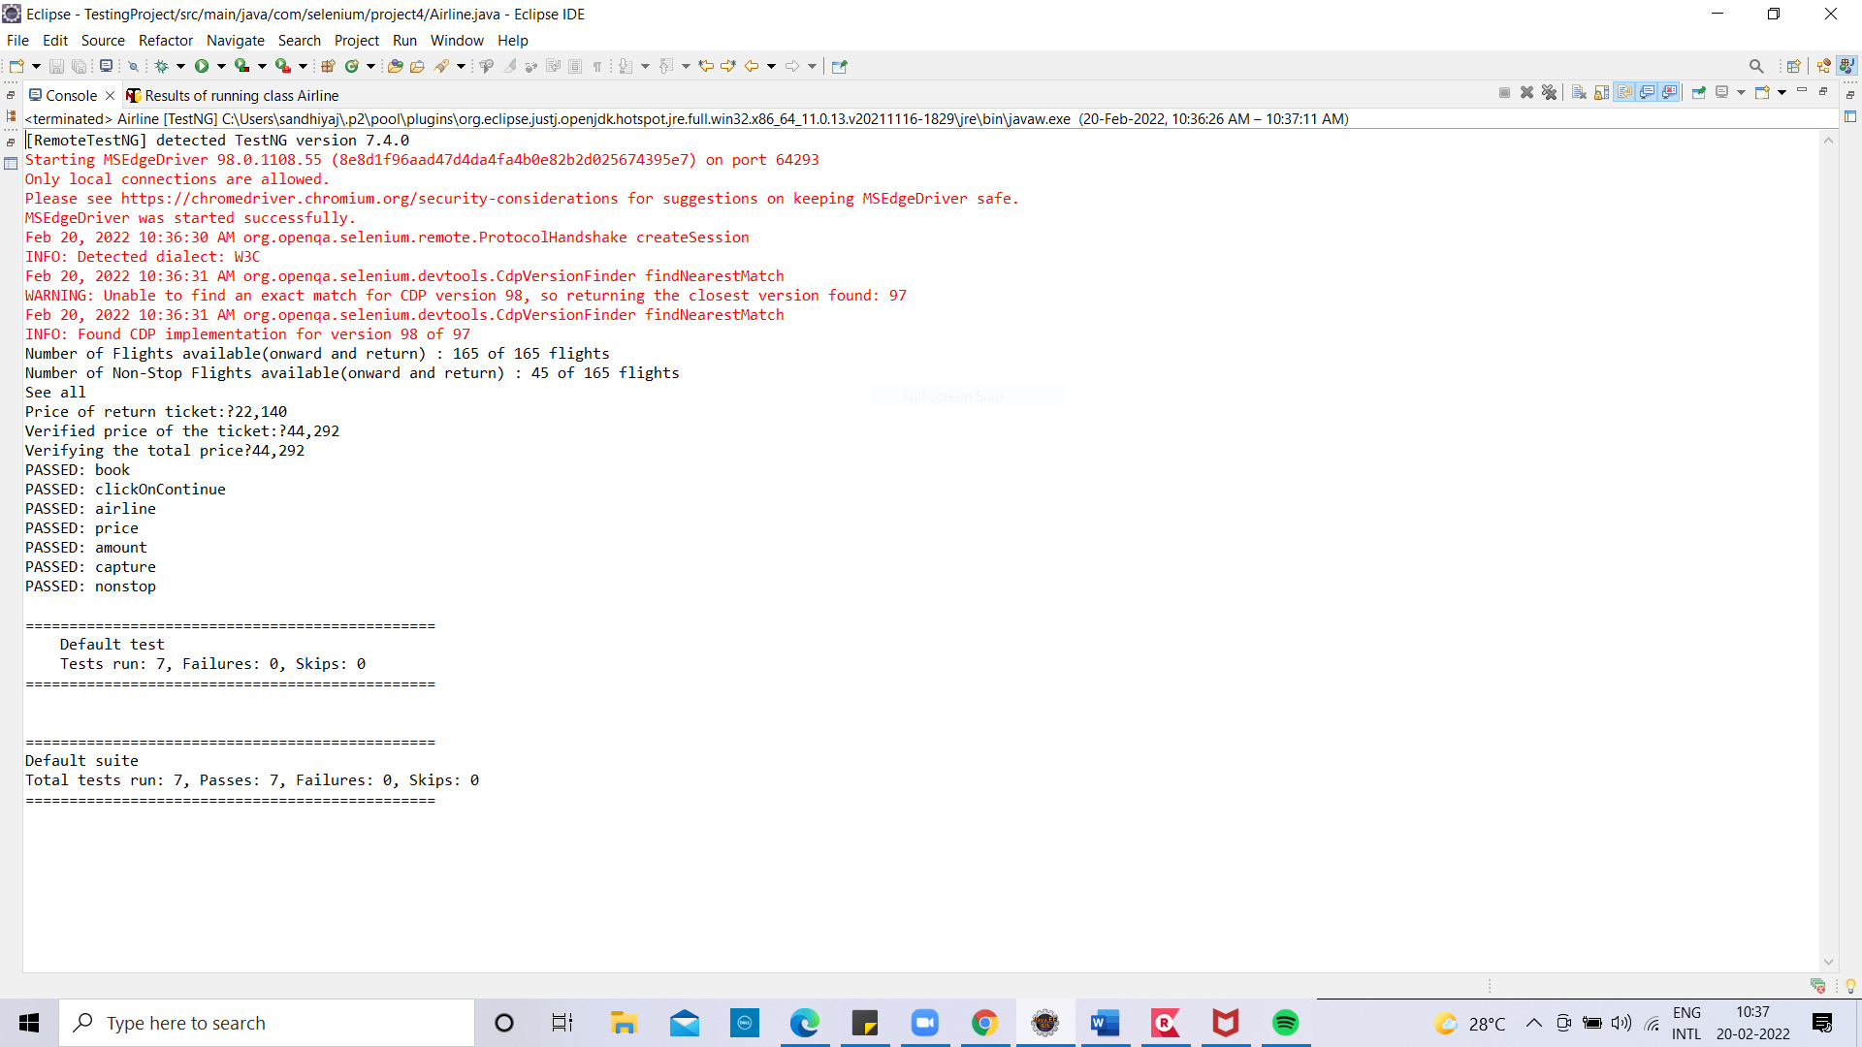
Output

Slide 11
Thank you

